Slide 1
GTA V Automated
Ganapathi Subramanyam Jayam
Balaji Dass
Kishore Bandi
Git Link

Slide 2
Problem statement
Here we are making a python program to automate the play of GTA V.
Also, here we are using aws sagemaker to train the deep learning model in order to predict the correct move in the game.

Slide 3





Tech stack

Slide 4
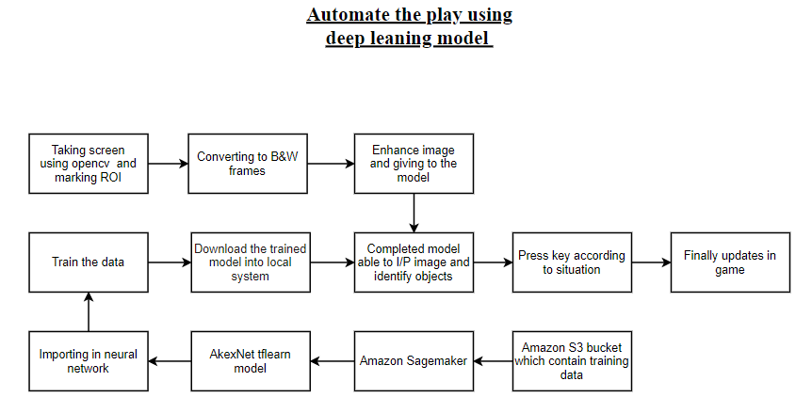
Flow Diagram

Slide 5
Important steps we went through:
We collected training data by playing game and used grabscreen script to capture our screen and getkeys script to capture our keys while playing game.
Then we preprocessed data using balanced script, there we divided the data into equal parts containing equal forwards,rights and lefts.
For capturing screen we have captured specific dimensions of screen and converted it to black and white and we used a network which has 3 outputs that determines the percentage of selection (i.e, forward,left and right) when we pass a grabbed screen image of 160*120 dimensions.

Slide 6
Then comes the aws role we used aws-sagemaker to create a jupyter notebook and connected it to a s3 bucket and trained the model using alexnet tflearn network.
Then we downloaded the trained model to local machine from s3 bucket and tested it with test data script.
If you want to try it in your machine download test_data.py, alexnet.py, grabscreen.py, getkeys.py from the github repository and run gtav in your system, you need to use tensorflow 1.14.0 and python 3.6.

Slide 7
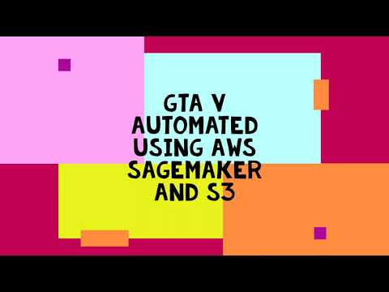
Live demo: GTA V Automated Using AWS

Slide 8
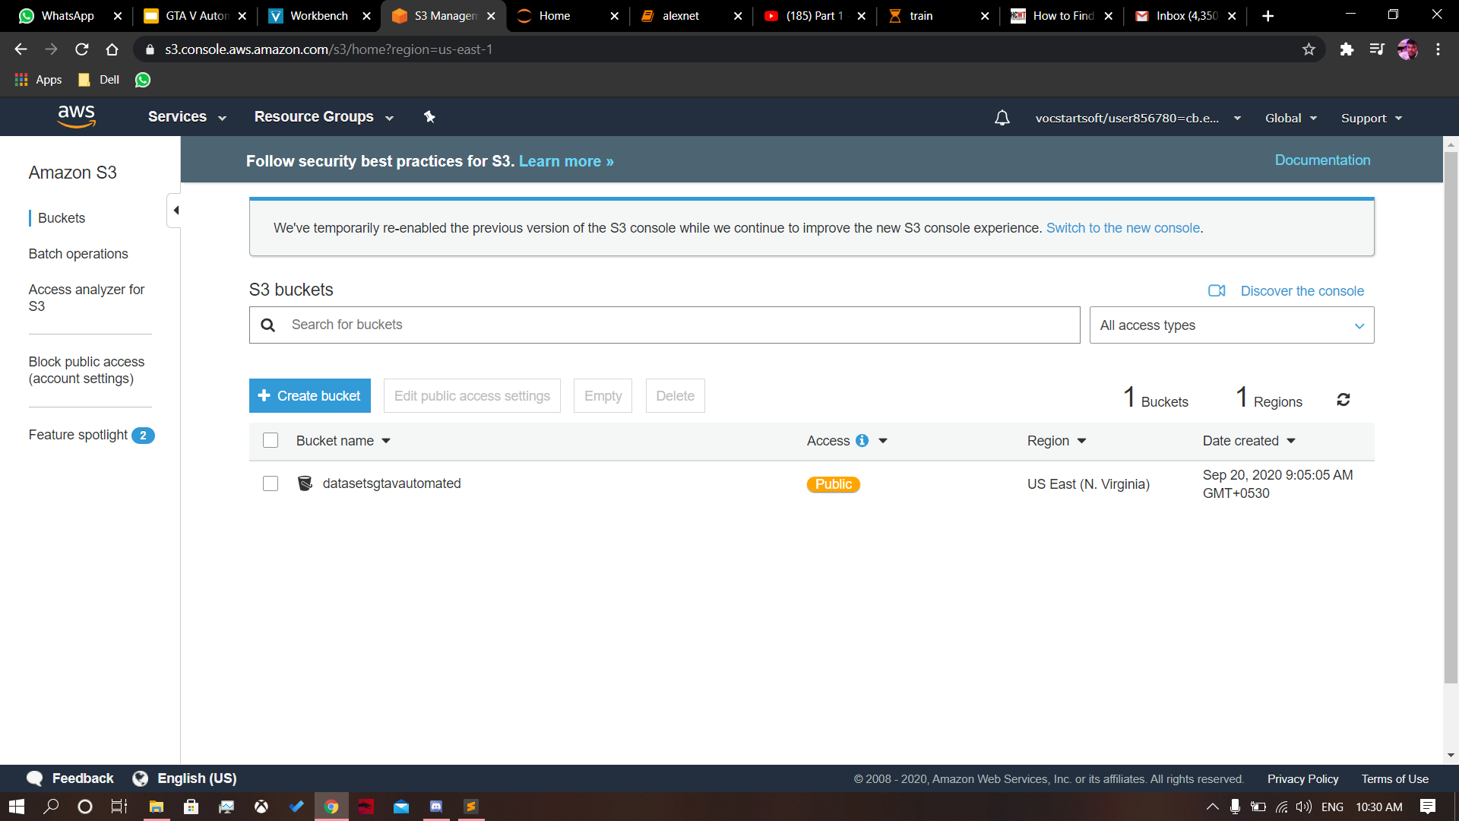
Gallary
S3 bucket

Slide 9
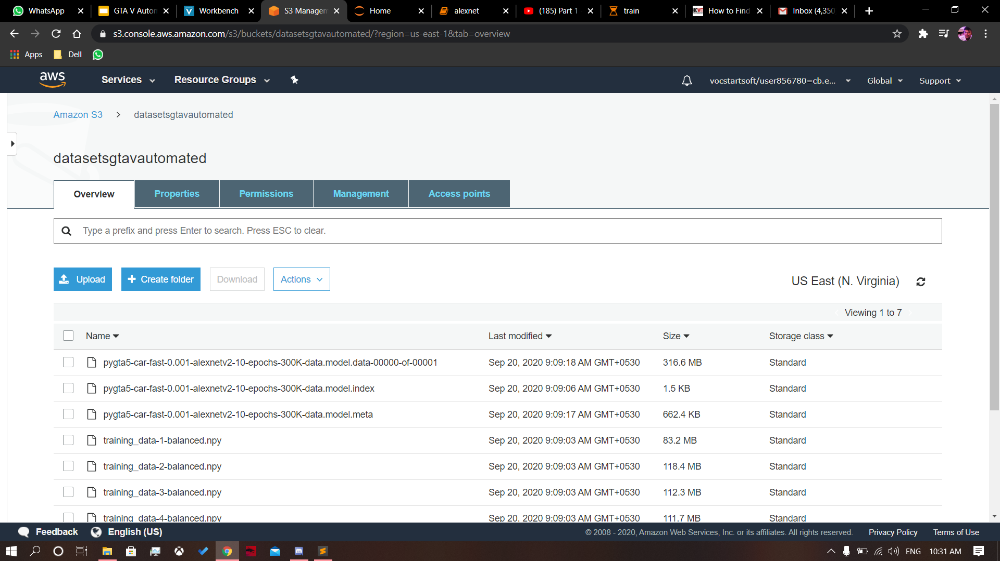
S3 contain all training dataset

Slide 10
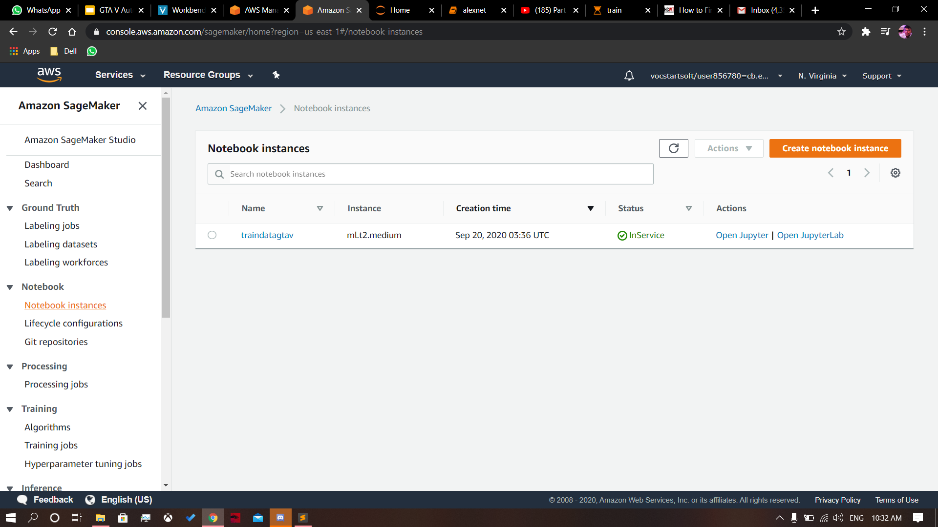
AWS Sagemaker

Slide 11
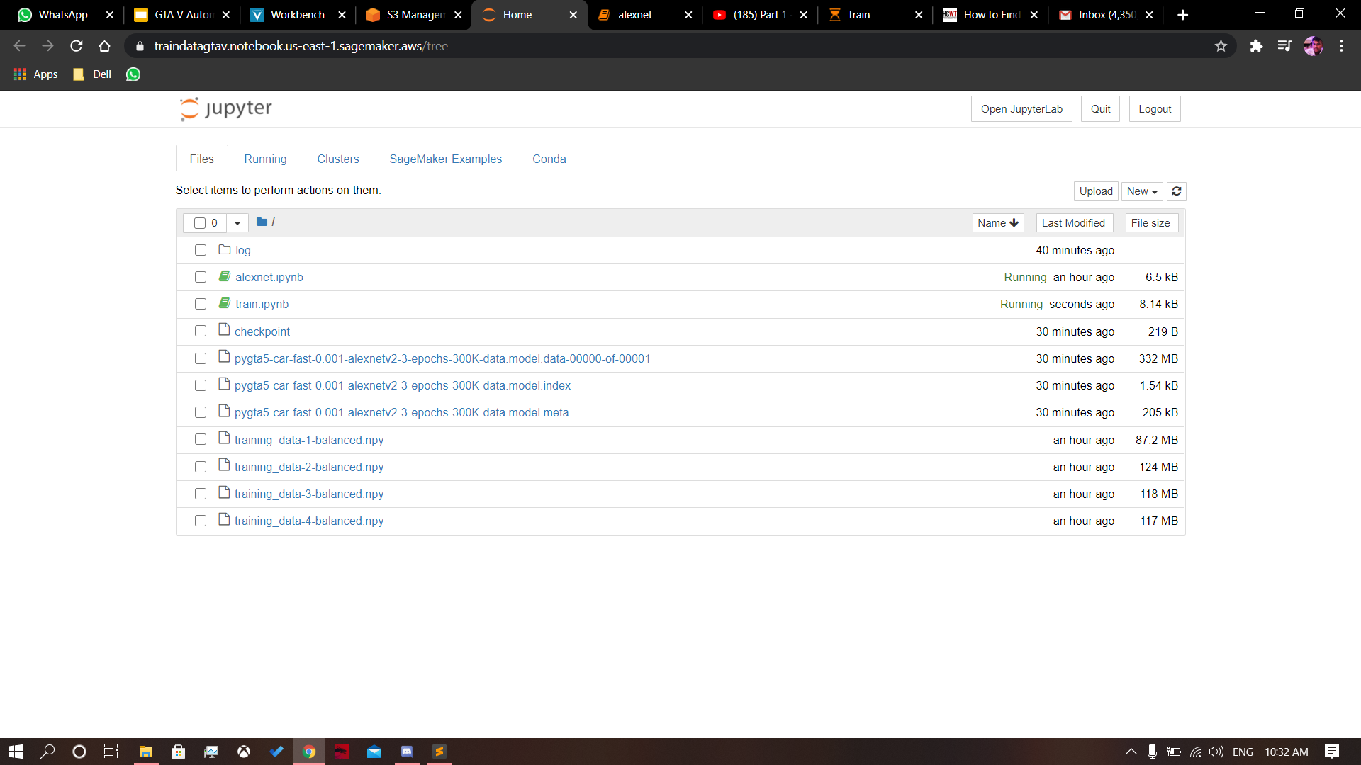
AWS Sagemaker - Jupyter notebook

Slide 12
Observations
The training data plays a vital role, so the more trained data gives more the perfect gameplay.
Not only GTA V but also we can play any simulated games when we have the appropriate dataset which can be trained from our model and may the gameplay.
AWS Sagamaker helped us lot to train the dataset in a faster way.

Slide 13
Reference
https://numpy.org/doc/stable/reference/generated/numpy.vstack.html
https://medium.com/@arccoder/process-the-output-of-cv2-houghlines-f43c7546deae
https://numpy.org/doc/stable/reference/generated/numpy.linalg.lstsq.html
https://pythonprogramming.net/python-fundamental-tutorials/
Alex Krizhevsky, Ilya Sutskever & Geoffrey E. Hinton. ImageNet.Classification with Deep Convolutional Neural Networks. NIPS, 2012.

